Slide 1

POULTRY SCIENCE:
Internal
Anatomy
Unit 5

Slide 2
Poultry Science:
Internal Anatomy
Unit 5: Segment 1
Skeletal System

Slide 3
Skeletal System of Poultry
Basic skeletal arrangement is generally analogous to that of mammals, but with several differences:
  Coracoids – a pair of bones that aid in wing movement and supplies additional support of the shoulder joint.
  Cervical Vertebrae (Neck Bones) – for an “S” shape, which are designed to minimize landing impact stresses on the head.
  Spinal Vertebrae – these are fused to add support for wing movement.
  Bones of birds are lighter in weight than they are in mammals.
  Some of the bones are hollow and actually act as part of the avian respiratory system! These are called pneumatic bones (pronounced “new-matic”) and include the skull, humerus, clavicle, keel (sternum), pelvic girdle, and the lumbar and sacral vertebrate.

Slide 4
Skeletal System of Poultry
Basic skeletal arrangement is generally analogous to that of mammals, but with several differences continued:
Another important type of bone in the avian skeleton are Medullary Bone (pronounced “med-u-larry”).
  These include the tibia, femur, pubic bone, ribs, ulna, toes, and scapula. The medullary bone is an important source of calcium when hens are laying eggs.
  Egg shells are primarily made of calcium and a hen mobilizes 47% of her body’s calcium to make just one egg shell.
  When in production, a commercial-type laying hen cannot obtain enough dietary calcium to allow for daily egg production. Without the medullary bone to draw calcium from, the egg shells would be very thin and weak!

Slide 5
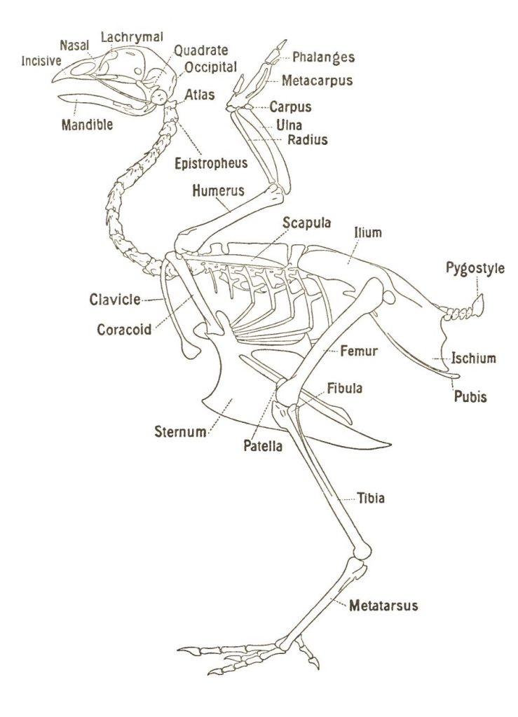
Organization of the Skeletal System
Axial Skeleton (trunk and head)
Skull: comprised of 23 bones
Sternum: only 1 bone
Vertebrae: 42 bones
Ribs: 14 individual (or 7 pairs)
Major flight muscles attach to the keel bone (sternum)!
Source: Poultry Hub Australia

Slide 6

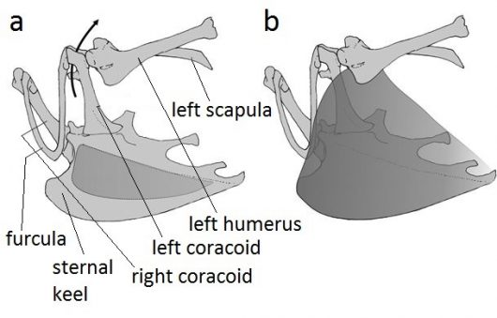
Organization of the Skeletal System
Pectoral Girdle
AKA the shoulder
Composed of the:
  Scapula (shoulder blade)
  Coracoid
  Clavicle (collar bone)
Source: British Ornithologists’ Union

Slide 7
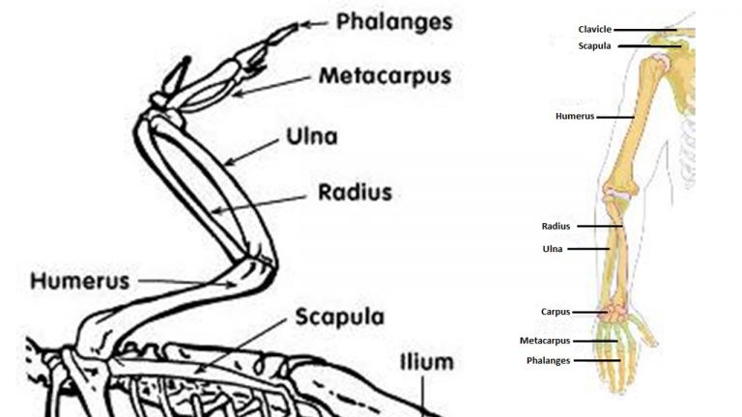
Organization of the Skeletal System
Wings
Very similar to the human arm
Composed of the:
  Humerus (upper arm or wing)
  Radius & Ulna (forearm or wing)
  Phalanges (hand or tip of the wing)
Source: Public Domain

Slide 8
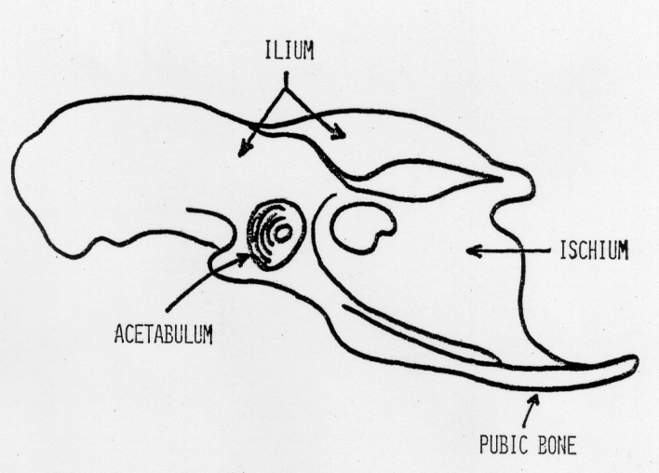
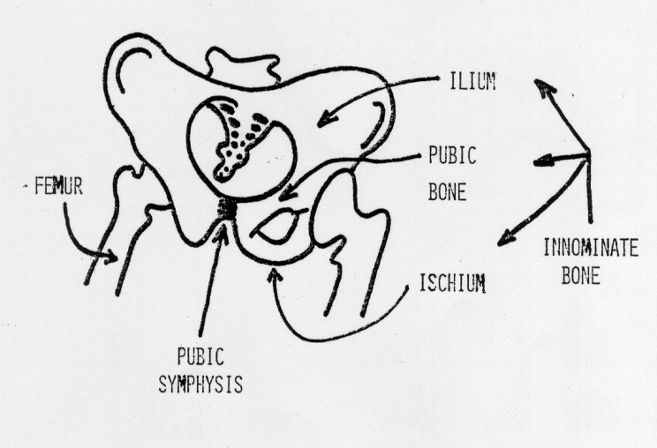
Organization of the Skeletal System
Pelvic Girdle
Composed of the:
  Ilium
  Ischium
  Pubic Bone
Femur (or thigh bone)
In humans, the pubic bone and backbone are separate!

Slide 9
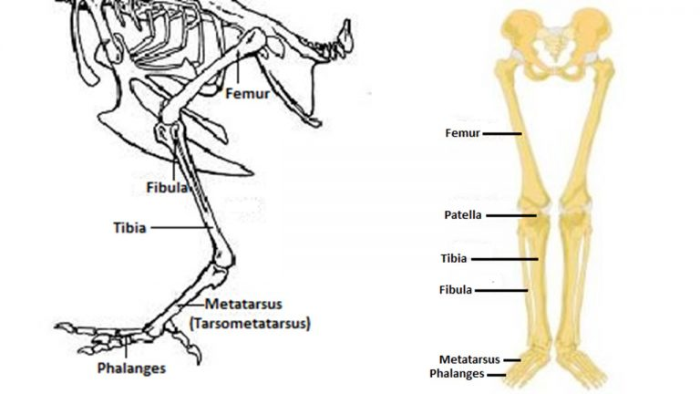
Organization of the Skeletal System
Tibia & Fibula (lower leg or drumstick)
Composed of the:
  Ilium
  Ischium
  Pubic Bone
Tarsometatarsus & Phalanges (foot)
Chickens actually walk on their toes!
Source: Public Domain

Slide 10
Classification of Bones
Long Bones
i.e. arm and leg bones
Usually have a central hollow region (diaphysis) linked to specialized ends (epiphysis)
Short Bones
i.e. wrists, ankles, carpals, and tarsals
They do not have a shaft, and do not increase dramatically in size
Flat Bones
i.e. ribs, skull, scapula
No shafts: spongey bone with layers of compact bone.
Irregular Bones
i.e. vertebrae
Bones that don’t fit other categories

Slide 11
Poultry Science:
Internal Anatomy
Unit 5: Segment 2
Muscular System

Slide 12
Just What Do Muscles Do, Exactly?
Movement – muscles work individually or in pairs
Heat – regulate body temperature
Shape and Form – surround, cover, and protect the bones, organs, etc.

Slide 13
Types of Muscles
Smooth – blood vessels, gizzard, intestines, organs, reproductive tract. Controlled by the Autonomic Nervous System (ANS).
Cardiac – specialized heart muscle
Skeletal (striated) – muscle responsible for voluntary movement and body shape. Attached to bones by tendons.
  This is the meat we eat!

Slide 14
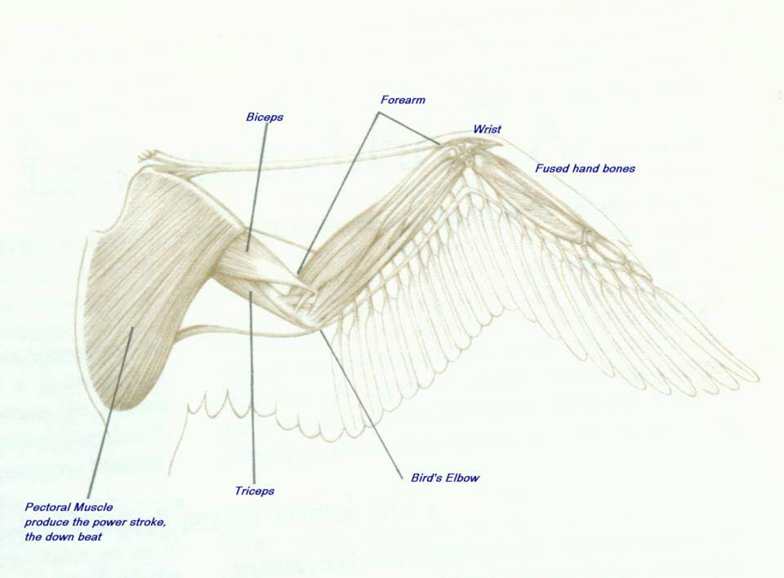
Taking Flight!

Slide 15
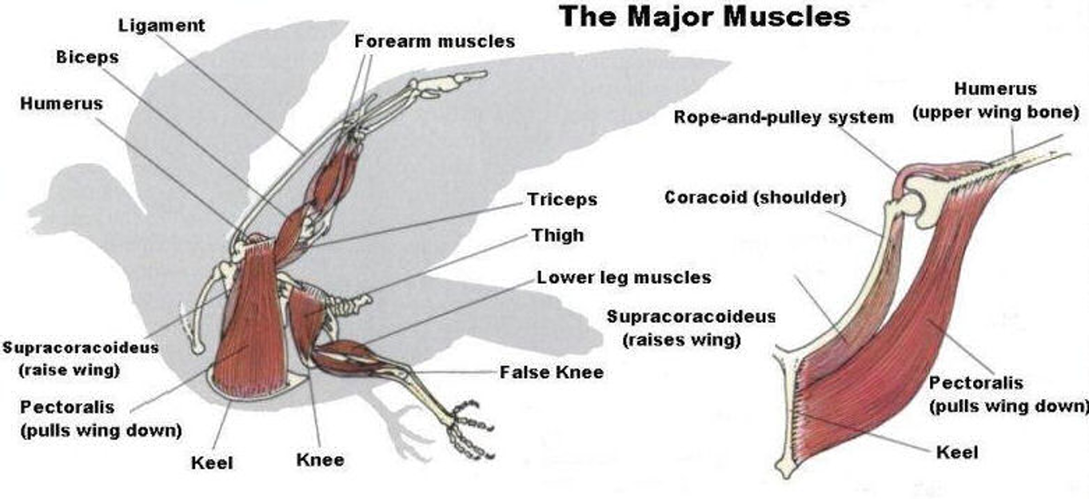
Taking Flight!

Slide 16
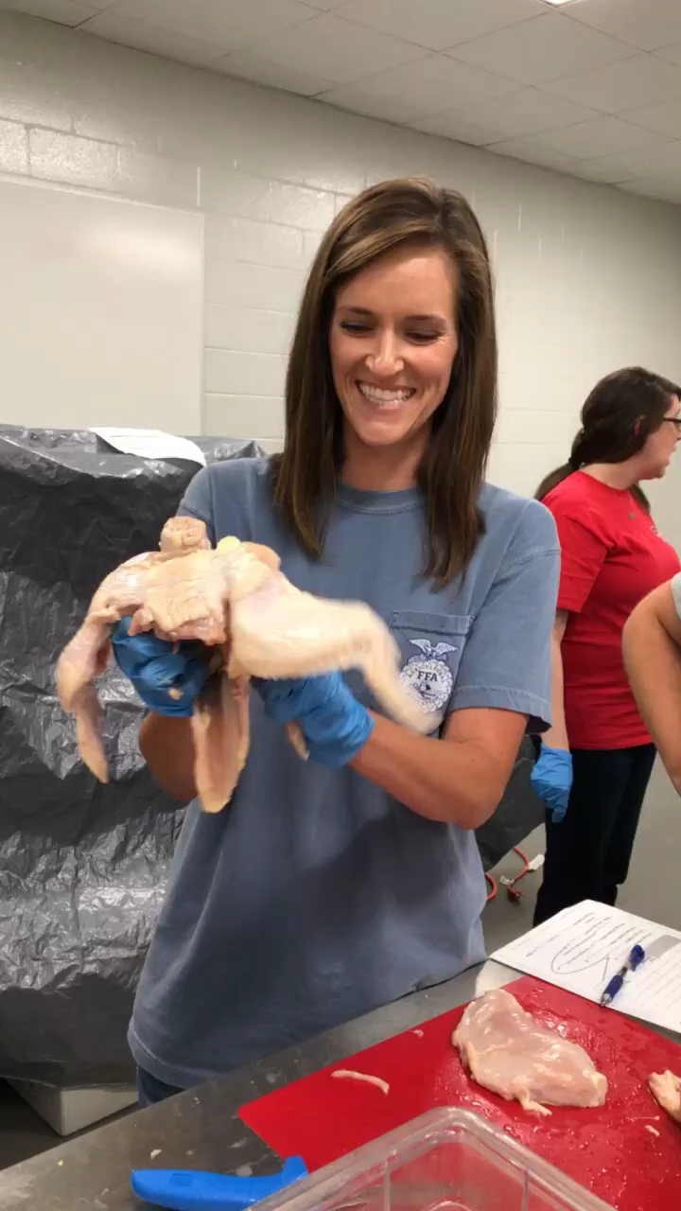
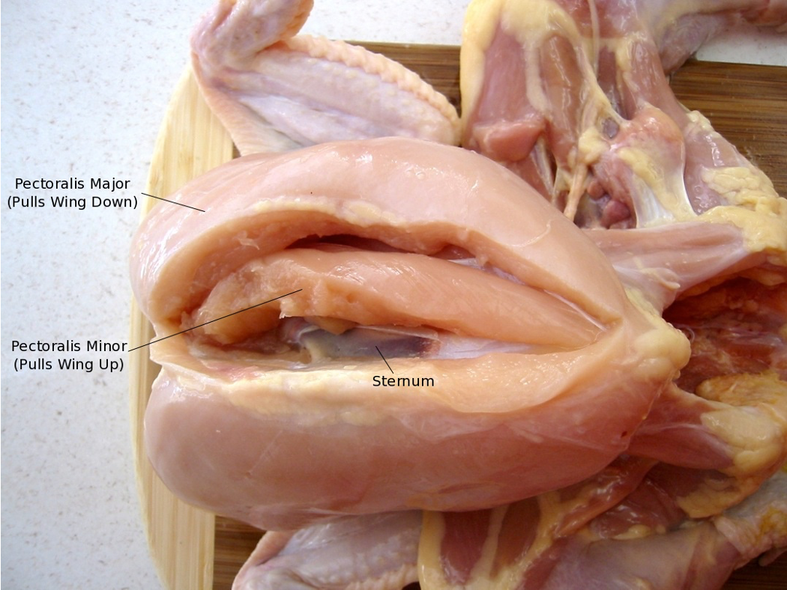
Taking Flight!

Slide 17
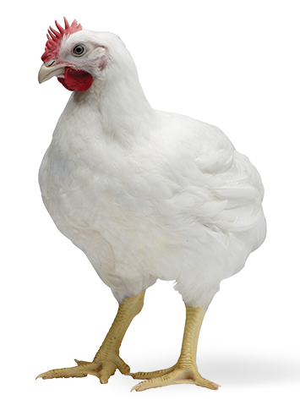
The Great Debate:
Dark Meat vs. White Meat
Chicken & Turkeys = primarily ground dwelling birds
White Meat – flight muscles, short bursts of movement, less myoglobin, fewer blood vessels, less fat, and less color
Dark Meat – leg muscles, longer usage, more continuous usage, more myoglobin, more blood vessels, more fat, and more color
Myoglobin – iron- and oxygen-binding protein found in muscle tissue

Slide 18
Fun Fowl Facts: Avian Muscles
Muscles and tendons of feet automatically lock when the bird bends their legs, allowing it to sleep while perched.
Birds don’t have diaphragms. They must use muscles to both inhale and exhale.
Dermal muscles allow the feathers to be fluffed up or smoothed down.
A specialized hatching muscle helps embryo break out of its shell!

Slide 19
Poultry Science:
Internal Anatomy
Unit 5: Segment 3
Circulatory System

Slide 20
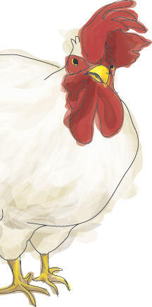
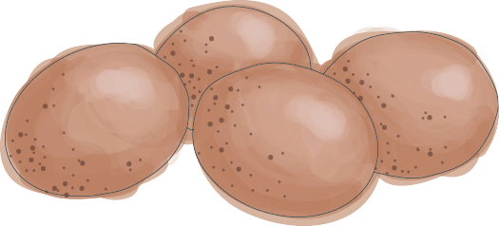
Avian Physiology
Due to their high energy demand associated with flight, when compared to other mammals, birds have:
Relatively High Blood Pressure
  Rooster: 190/150
  Hen: 150/125
Relatively High Metabolic Rate
Relatively High Heart Rate
  Body size plays a major role
  Chickens: 350-475
Relatively High Body Temperature
  104-106*F

Slide 21

Avian Circulatory System
Sustained flight is metabolically demanding and requires an efficient circulatory system to provide oxygen and fuel (energy) to the body (cells) while removing toxic metabolites for excretion.

Slide 22
Functions of the Circulatory System
Transport of:
  Nutrients from the alimentary tract to the tissues
  Blood Gases (i.e. O₂ and CO₂) from lungs to tissues and back to lungs
  Metabolic Waste – the removal of waste products from the tissues and products of metabolism
  Hormones produced by the endocrine system to their target tissues
  Immune Cells for protection (leukocytes and antibodies)

Slide 23
Functions of the Circulatory System
Regulation of Fluid Content of the Body
  Acid-Base Balance (pH)
  Blood Pressure & Heart Rate
Thermoregulation
  Vasoconstriction (Cold)
  Vasodilatation (Hot)

Slide 24
Circulatory System Classification
The circulatory system can be classified into 5 Categories:
  Blood
  Heart
  Arteries
  Capillaries
  Veins

Slide 25
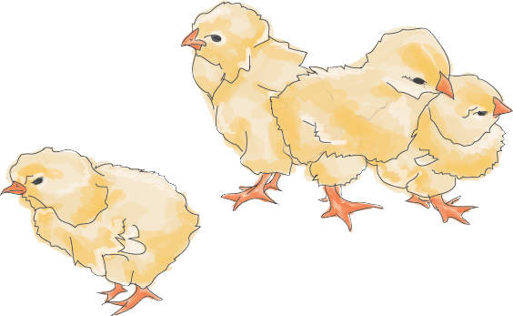
Fun Fowl Facts:
The avian kidney is 2x larger than mammalians due to the high metabolic demand.
Birds have NO urinary bladder (except for rhea and ostrich)
  What does this mean? Chickens do not urinate (urea)!

Slide 26
Uric Acid vs. Urea
Uric Acid (urate) – The waste product of protein metabolism in the chicken
Urea (in urine) – The waste product of protein metabolism in other domestic livestock.
One of the most dangerous biological waste products results from the breakdown proteins:
The main waste product formed during this decomposition is ammonia (NH₃), which is toxic.
  Urination in mammals eliminates urea.

Slide 27
Uric Acid vs. Urea
Although effective, urinating wastes water!
Thus, birds have developed a different, less water-wasting process for dealing with their body’s ammonia:
  Rather than converting their ammonia to urea, they mostly convert it to uric acid (C₅H₄N₃O₃).
  This is excreted as a white paste or even a dry, white powder and very little water is wasted.

Slide 28
Endocrine System in Poultry
The Endocrine System in poultry is made up of:
  Glands
  Hormones
  Receptors
  It is the communication link between the nervous system, reproduction, immunity, metabolism, and the behavior of a chicken!

Slide 29
Poultry Science:
Internal Anatomy
Unit 5: Segment 4
Digestive System

Slide 30
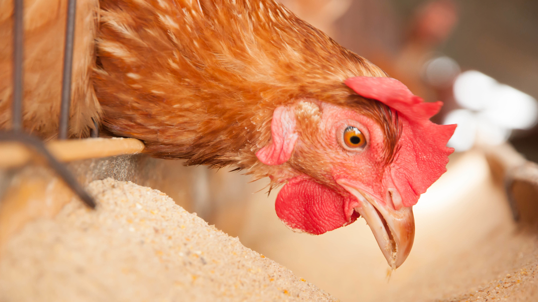
Functions of the
Digestive System
Mechanical & chemical breakdown of food
Absorption of nutrients or breakdown products
Exertion of undigested material

Slide 31
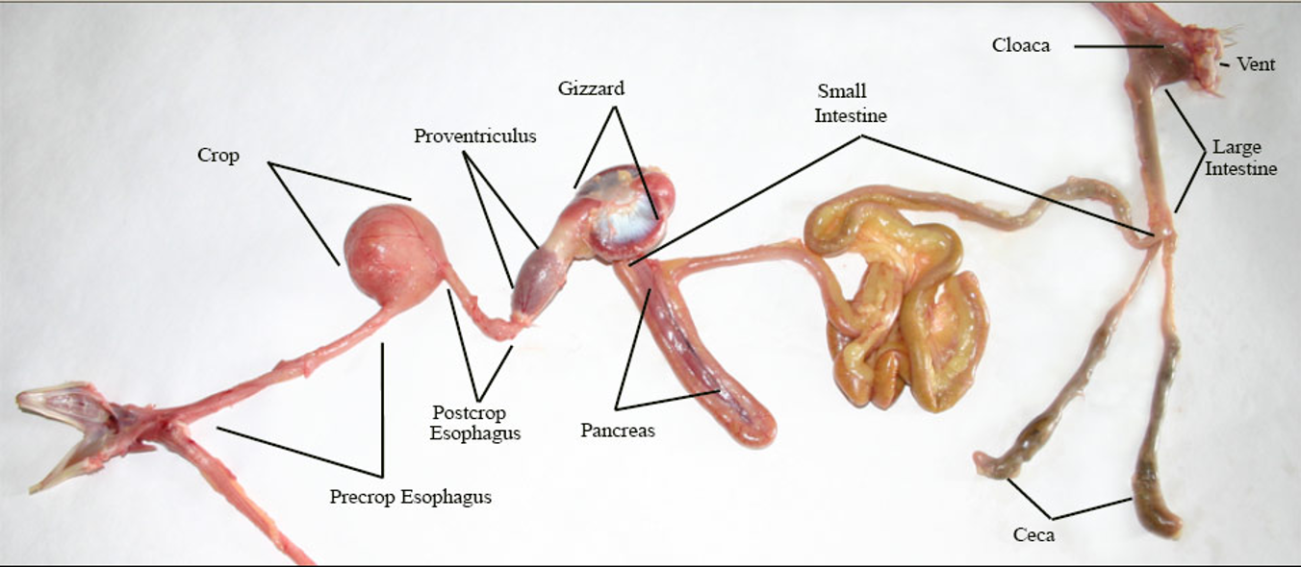
Digestive System of a Chicken

Slide 32
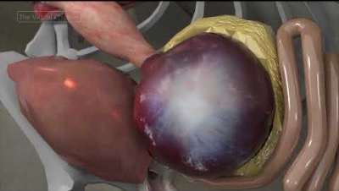

Slide 33
Avian Digestive Tract
Mouth/Beak – gather and bread down food
Esophagus – tube from mouth to stomach that is open at the mouth end
Crop – feed storage and moistening
Proventriculus – glandular stomach (HCI and gastric juices); enzymatic
Gizzard – muscular stomach; mechanical breakdown

Slide 34
Avian Digestive Tract
Small Intestine – enzymatic digestion and absorption
  Functions: digestion of proteins, carbohydrates, & fats; absorption of the end products of digestion
Ceca – essentially non-functioning in monogastrics
Large Intestine – bacterial activity, water absorption, and waste storage
Cloaca – common chamber for GI and urinary tracts
Vent – common exit for GI and urinary tracts

Slide 35
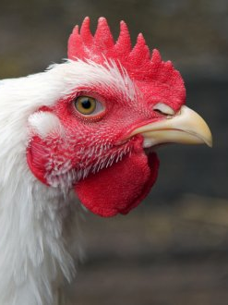
Mouth
Chickens do not have teeth!
No soft palate so swallowing depends on gravity and negative pressure.
Tongue is rigid and has comparatively few taste buds.
Saliva

Slide 36
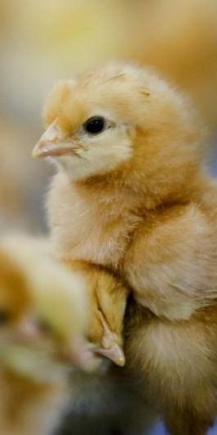
Beak
Commercial poultry (chicken and turkey) beaks are often trimmed in an effort to prevent feather pecking, vent pecking, and cannibalism.
Most commonly done to egg laying strains of birds and broiler breeders, etc. but not broilers since they reach slaughter weight at 6 weeks.
Decreases stress, nervousness, and fear among birds living in close confinement.
Research shows chicks do not experience pain from beak trimming at 2-9 days of age.
Alternatives to beak trimming could be genetic beak alterations or hanging objects in habitats which is shown to reduce aggressive behaviors.

Slide 37
Oropharynx & Swallowing
Oropharynx – the structure through which air and feed pass
In birds, no demarcation exists between where the mouth ends, and pharynx begins.
While eating, when a bird extends their neck, the position of the trachea changes so that it prevents the downward passage of the food into the respiratory system.

Slide 38
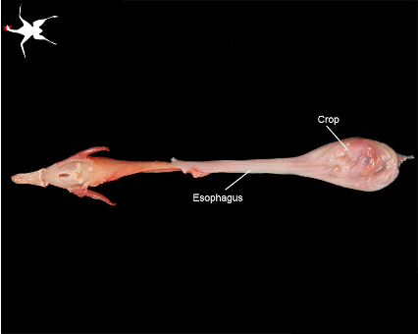
Oropharynx & Esophagus
After swallowing, the food travels down the esophagus.
The chicken esophagus is approximately 35 cm long, covering 17% of the length of the entire digestive tract!

Slide 39
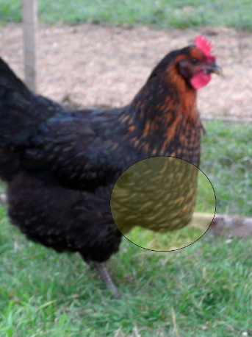
Crop
The crop is an expansion of the esophagus and is used to temporarily store food and will only fill with food when the proventriculus or gizzard is occupied.
Not essential for normal growth since its main purpose is for food storage, not digestion.

Slide 40
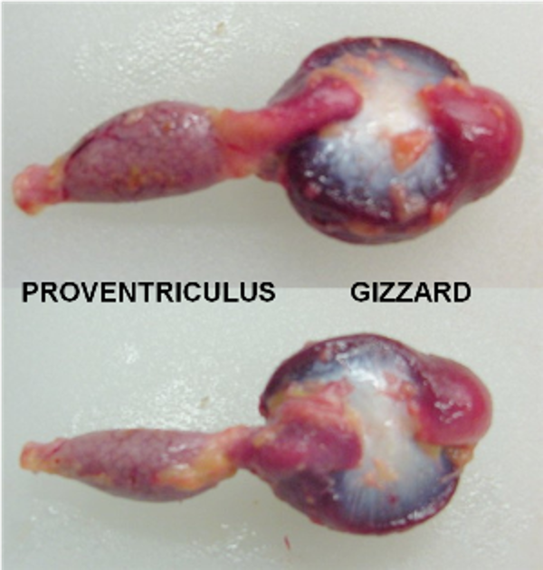
Proventriculus & Gizzard
In mammals, the stomach consists of a single chamber. In birds, the stomach consists of two chambers!
Proventriculus:
  Small organ through which ingested feed passes rapidly.
  The fluid secreted by the proventriculus is very similar to those in the stomach of non-ruminant mammals.
Gizzard:
  Function is the mechanical action of mixing and grinding the feed.
  Very important since chickens do not have teeth!
  Super powerful organ that works with enzymes in addition to the physical grinding to break the food down.

Slide 41
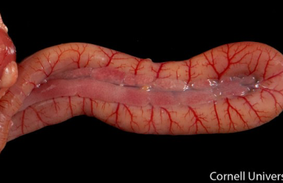
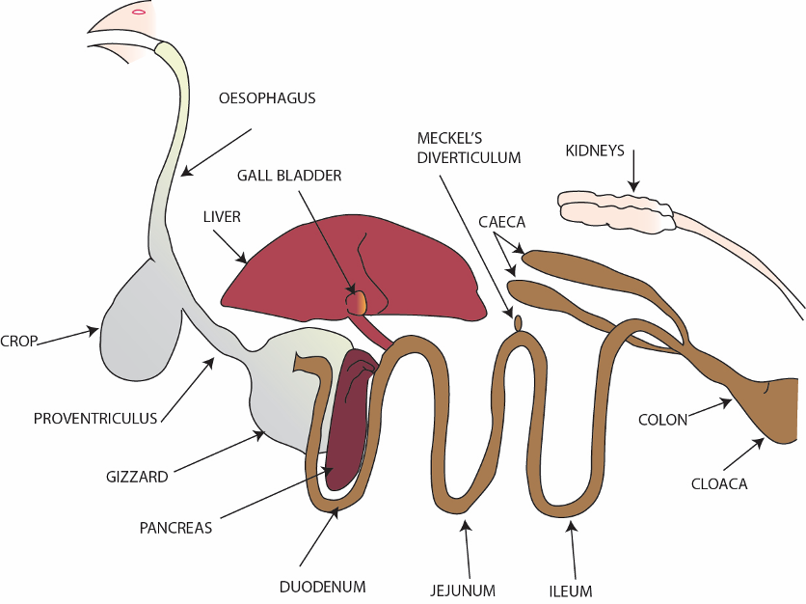
Small Intestine
Duodenum -> Jejunum -> Ileum
Most digestion and absorption occurs in the small intestine.
Food passage in a broiler takes roughly six hours!

Slide 42
Pancreas
Endocrine and Exocrine function
Pancreatic duct (with bile duct) drains into the ascending loop of the duodenum by a common papilla.

Slide 43
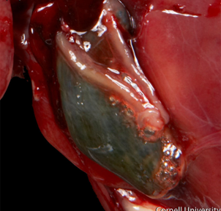
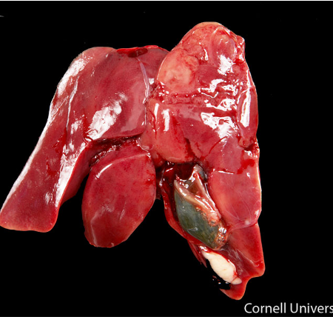
Liver
Bi-Lobed organ
  Right lobe is larger than the left
Primary digestive role is production of bile
  Gall Bladder (bright green part)

Slide 44
Poultry Science
Curriculum References
Jessica Fife, UGA Dept. of Poultry Science Outreach Coordinator, UGA Dept. of Agricultural Leadership, Education, & Communication MAEE Candidate
Barry Croom, UGA Dept. of Agricultural Leadership, Education, & Communication Professor
Ashley Yopp, UGA Dept. of Agricultural Leadership, Education, & Communication Assistant Professor
Georgia Agriculture Education
Andrew Benson, UGA Dept. of Poultry Science Assistant Professor
Brian Jordan, UGA Dept. of Poultry Science Assistant Professor, UGA College of Veterinary Medicine Assistant Professor
University of Arkansas Bumpers College of Poultry Science – Poultry Science Dual Curriculum Course
Julia Gaskin, UGA Dept. of Crop and Soil Sciences Sr. Public Service Associate
Glendon Harris, UGA Dept. of Crop and Soil Sciences Professor & Extension Agronomist
Brian Kiepper, UGA Dept. of Poultry Science Associate Professor
Claudia Dunkley, UGA Dept. of Poultry Science Public Service Associate
Casey Ritz, UGA Dept. of Poultry Science Professor
USPOULTRY & USPOULTRY Poultry Science Curriculum
Tom Tabler, Mississippi State University Department of Poultry Science Extension Professor
Jacquie Jacob, University of Kentucky
Jeanna Wilson, UGA Dept. of Poultry Science Professor
Kelly Sweeney, UGA Dept. of Poultry Science Ph.D Candidate
Merck Veterinary Manual
University of Maryland Extension
Poultry Hub
Brian Fairchild, University of Georgia Department of Poultry Science Professor
Centers for Disease Control
National FFA Organization

